Slide 1
Bike-Share Navigation
Data: 202004-divvy-tripdata.csv (April Month)
(Source: https://divvytripdata.s3.amazonaws.com/index.html)

Slide 2
Problem Statement
Design marketing strategies aimed at converting casual riders into annual members

Slide 3
Analytical Goals
How annual members and casual riders differ
Why casual riders would buy a membership
How digital media could aspect their marketing tactics

Slide 4
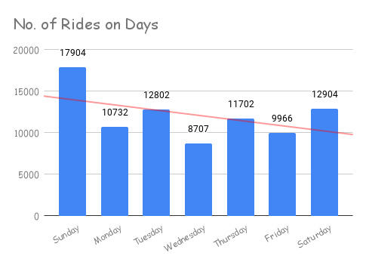
No. of rides in Each day
Downward Trend
The number of rides have been falling during weekdays and rises during holiday.

Slide 5
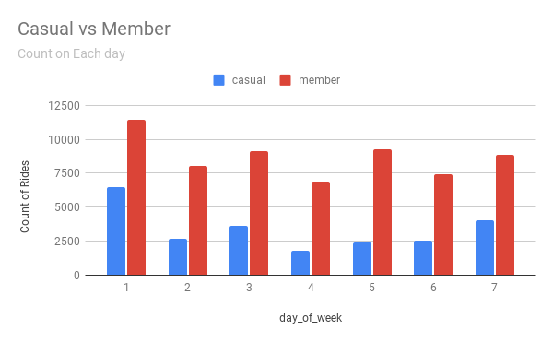
No. of rides in Each day (Casual vs. Member)
Number of rides used by Annual Members is more than No. of rides used by Casual Member on Every day.

Slide 6
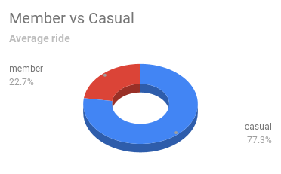
Average Ride (Casual vs. Member)
Average ride duration travelled by Annual Members is less than Average ride duration travelled by Casual Member on Every day.

Slide 7
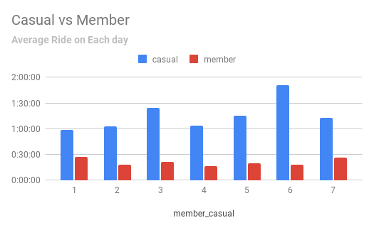
Average Ride on Each day. (Casual vs. Member)
Average ride duration travelled by Annual Members is less than Average ride duration travelled by Casual Member on Every day.
Casual Member travels for long distance whereas Annual member travels for short distances

Slide 8
The no. of active riders is less on Wednesday. Thus, we can improve this by providing an amount of discount for Annual Members decided to have a ride on Wednesday.
The average ride of Casual Member is greater than Annual Member. Introducing discount if the distance travelled is more than certain limit, if they get converted to an Annual Member.
Introducing referral rewards to Annual Members when they invite casual members and gets converted to an Annual Member through unique id.

Slide 9
Thank you.

